Slide 1
Summarize Data Protection and Compliance Concepts
CompTIA Security+ Exam SY0-701
Lesson 16

Slide 2
Data Classification and Compliance
Lesson 16
Topic 16A

Slide 3
Data Types
Categorizing or classifying data based on its inherent characteristics, structure, and intended use
Regulated Data
Trade Secrets
Intellectual Property
Legal and Financial Data
Many Others

Slide 4
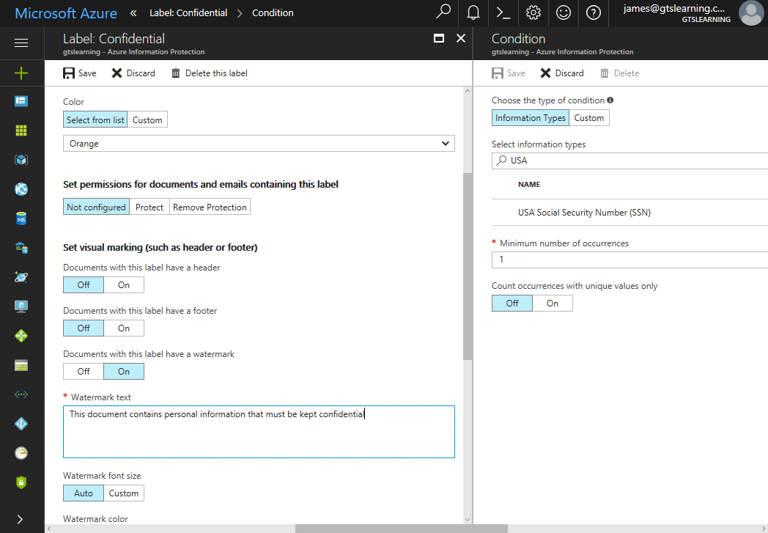
Data Classifications
Identifying the importance and associated protections required to protect different types of data
Typically defined in 3 levels
Using Microsoft Azure Information Protection to define an automatic document labeling and watermarking policy. (Screenshot used with permission from Microsoft.)
Notes:
Discuss the difficulty of applying classifications in a consistent way. It is best not to create too many categories.

Slide 5
Data Sovereignty and Geographical Considerations
Data Sovereignty
  A legal jurisdiction restricting processing and storage of data on systems that do not physically reside within that jurisdiction
Geographical Considerations
  Organizations must ensure data remains within a designated boundary
  Access controls to validate a user's geographic location

Slide 6
Privacy Data
Personally identifiable or sensitive information associated with an individual's personal, financial, or social identity
Data that could infringe upon an individual's privacy rights, if exposed or mishandled
Data protection and privacy laws safeguard both data types
  Rapidly evolving legal environment
Privacy data is closely associated with the rights of individuals to control the use and disclosure of their personal information
Individuals have the right to access, correct, and request the deletion of their privacy data

Slide 7
Privacy Data
Legal Implications
  Protecting privacy data carries significant local, national, and global legal implications
  Many countries have specific privacy laws and regulations that dictate how personal data should be handled within their jurisdiction
  The General Data Protection Regulation (GDPR) in the European Union has had a substantial impact globally by setting high privacy and data protection standards
  GDPR applies to organizations that process the personal data of EU residents, regardless of their physical location
Roles and Responsibilities
  Data Controller and Data Processor
    Both roles are responsible for ensuring personal data protection in compliance with data protection laws and regulations
  Data Subject

Slide 8
Privacy Data
Right to Be Forgotten
  Fundamental principle outlined in the General Data Protection Regulation (GDPR)
  Grants data subjects the right to request the deletion of their personal data under certain circumstances
Ownership of Privacy Data
  It is not easy to attribute traditional notions of ownership to privacy data
  Many data protection laws place the emphasis on protecting the data subject
Data Inventories and Retention
  Detailed record of personal data being collected, processed, and stored
  Retain personal data only for as long as necessary to fulfill the intended purpose or as required by law

Slide 9
Privacy Breaches and Data Breaches
When information is read, modified, or deleted without authorization
Organizational Consequences
  Reputation damage
  Identity theft
  Fines
  Intellectual Property (IP) theft
Breach Notification
  Requirements for different types of breach are established in laws and in regulations
  Public Notification and Disclosure
Notes:
Note that the definition of a breach can be quite narrow. It is important to review legislation and determine precise compliance requirements.

Slide 10
Compliance
Security compliance refers to organizations' adherence to applicable security standards, regulations, policy and best practices
Compliance Issues
  Legal & Regulatory Noncompliance
  Software Licensing
  Contractual Noncompliance

Slide 11
Monitoring and Reporting
Systematically assessing, evaluating, and reporting an organization's adherence to laws, regulations, contracts, and industry standards
Internal and External Compliance Reporting
Compliance Monitoring

Slide 12
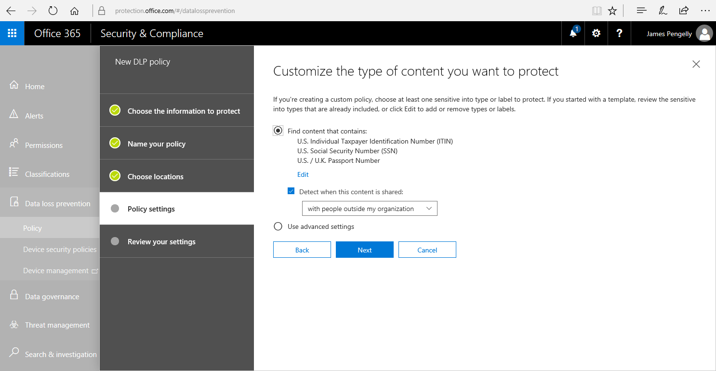
Data Protection and Data Loss Prevention
Data requires different protection methods for each state
  Data at rest
  Data in motion
  Data in use
Data Loss Prevention
  Automates the discovery and classification of data types and enforce rules so that data is not viewed or transferred without a proper authorization
Creating a DLP policy in Office 365. (Screenshot used with permission from Microsoft.)
Notes:
Make sure students can distinguish the data states and the different types of encryption that can be used.

Slide 13
Data Classification and Compliance
Data Types
Data Classifications
Data Sovereignty and Geographical Considerations
Privacy Data
Privacy Breaches and Data Breaches
Compliance
Monitoring and Reporting
Data Protection
Data Loss Prevention
Notes:
Take some time at the end of each topic to answer questions. You can use the review questions for discussion in class or set them for students to complete individually during or after class.

Slide 14
Personnel Policies
Lesson 16
Topic 16B

Slide 15
Conduct Policies
Operational policies include credential management, data handling, incident response and those governing employee conduct and respect for privacy
Acceptable Use Policy
Code of Conduct
Social Media Use and Analysis
Use of Personally Owned Devices
Clean Desk Policy

Slide 16
User and Role-Based Training
Untrained users represent a serious vulnerability because they are susceptible to social engineering and malware attacks and may be careless when handling sensitive or confidential data
Appropriate security awareness training needs to be delivered to employees at all levels, including end users, technical staff, and executives
Training should be tailored to the audience and job role
Notes:
Security awareness programs are described in SP800-50 (nvlpubs.nist.gov/nistpubs/Legacy/SP/nistspecialpublication800-50.pdf).

Slide 17
Training Topics and Techniques
Popular Techniques
  Computer-Based Training
  Gamification
  Phishing Campaigns
Topics
  Situational Awareness
  Reporting and Escalation Procedures
  Policy/Handbooks
  Insider Threat
  Password Management
  Removable Media and Cables
  Hybrid/Remote Work Environments

Slide 18
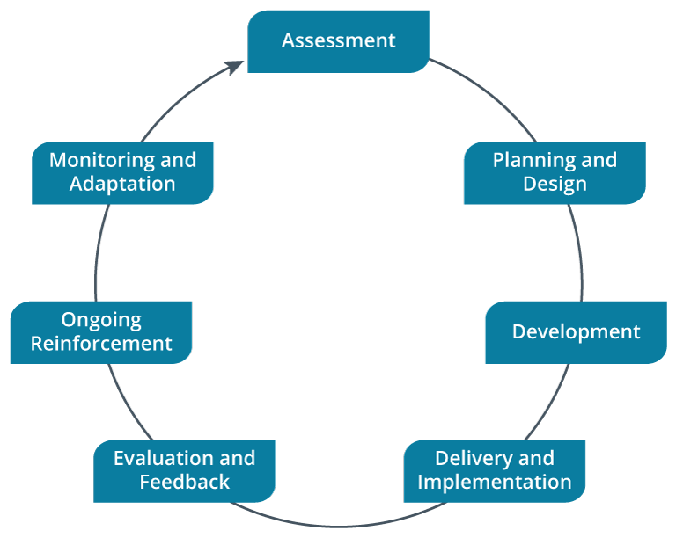
Security Awareness Training Lifecycle
Security awareness training practices should follow a lifecycle approach consisting of several stages
Security Awareness Training Lifecycle.

Slide 19
Personnel Policies
Conduct Policies
User and Role-Based Training
Training Topics and Techniques
Security Awareness Training Lifecycle
Notes:
Take some time at the end of each topic to answer questions. You can use the review questions for discussion in class or set them for students to complete individually during or after class.

Slide 20
Assisted Lab: Training and Awareness through Simulation
Challenge Lab: Discovering Anomalous Behavior

Slide 21
Summary
CompTIA Security+ Exam SY0-701
Lesson 16

